Slide 1
Chylothorax
Katrina Bellan
Virginia Tech Dietetic Intern
October 17, 2011

Slide 2
Objectives
Define chylothorax and related terms
Explain the disease pathophysiology
Assess pt admission for chylothorax dx
Interpret related lab values and describe pertinent medications
Address appropriate MNT and supplement use
Monitor and Evaluate progress and adherence to diet through follow up and calorie count

Slide 3
Key Words
Chyle (lymphatic fluid): Milky white fluid that contains protein, fat, cholesterol, lymphocytes, and electrolytes. Transport of chylomicron.
Thoracic duct: Paper thin, valved, tubular structure 2-3 mm in diameter. Main conduit of the lymphatic system and transports 60-70% of ingested fat to the blood stream.
Chylothorax: occurs when chyle collects in the pleural space of the thoracic cavity and cannot drain from the thoracic duct into the subclavian vein

Slide 4
Pathophysiology
Secondary to injury; thoracic surgery, abdominal surgery, esophagectomy, lymphoma, neck trauma, thyroid lobectomy, lung lobectomy
Occurs when chyle collects in the thoracic cavity and fills the pleural space
Dietary fat promotes chyle production.

Slide 5
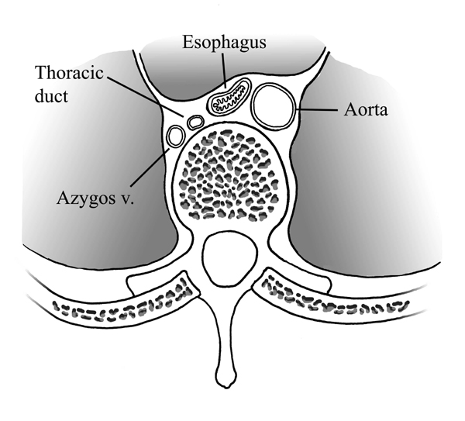

Slide 6
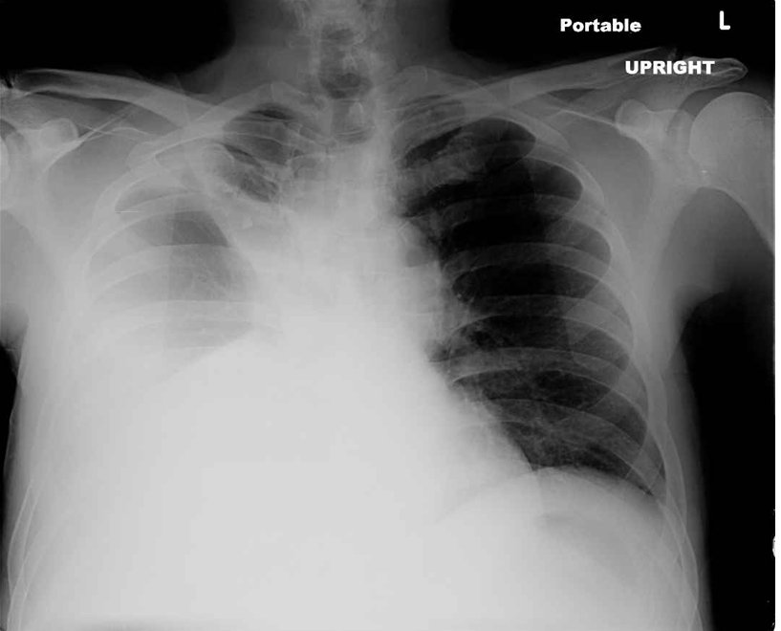
Chyle Fluid

Slide 7
Criteria for Diagnosis
Triglyceride level: >110 mg/dl
Presence of chylomicrons in chest tube drainage
Positive Sudan Stain test
High volume chest tube output that turns milky white after feeding (enteral or PO intake)

Slide 8
Medical Treatment
Risk of respiratory failure and eventual death if not treated
Placement of chest tube
Removal of fluid from thoracic cavity to the abdominal cavity
Use of diuretics
Re-operation with thoracic duct ligation within five to seven days after initial procedure

Slide 9
Common Nutrition Therapies
Fat-free diet required to prevent chyle build up in pleural space
Fat-free PO diet or parenteral/ enteral feedings
Use of medium-chain fatty acids (MCT)
Adding vitamin and mineral supplements as necessary
Notes:
MCT: are medium-chain (6 to 12 carbons) fatty acid esters of glycerol. MCTs passively diffuse from the GI tract to the portal system (longer fatty acids are absorbed into the lymphatic system)

Slide 10
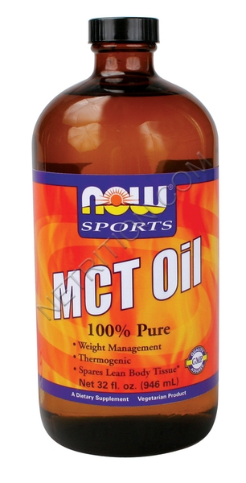
Communicating through the consult:
“Nutrition consult for MCT oil”
Why was this ordered?
PT currently on clear liquid diet. MD believed pt needed to increase kcals
Absorbed passively through the GI tract and not the lymph as longer chains are.
My goal: Create a diet that meets protein and calorie needs without MCT oil
Why?
MCT oil is not palatable, poor compliance, very expensive

Slide 11
Meet the Patient
DJ, 75 year old Male, Middle Eastern
Admitted 8/25/11
DX: Chylothorax post lobectomy
Post exploratory redo thoracic duct ligation
PMH: HTN, DMII, lung CA, anemia, thyroid nodule, GERD
DM has been controlled for over 20 years with diet alone
Pt very willing to comply with orders

Slide 12
Anthropometrics
Ht: 172.7 cm, Wt: 63.6 kg, IBW: 70 kg +/- 10% BMI: 21.2 kg/m2
Wt stable for as long as pt can remember. Pt reports suspicion of minor wt loss in hospital but unsure of amount or origin.
Physical Assessment of Nutrition Status:
Pt appearance appropriate for age. Skin is intact and he is comfortable and relaxed.

Slide 13
Medications
Drug | Classification | Purpose/Use | Possible Nutrition Implications
Miralax, Dulcolax | Laxative | Prevent/reduce constipation | Reduce bloating, improve GI
Maalox Antacid | Antacid | Antidiarrheal/Antinausent | Relieve n/v
Benicar | ACE inhibitor | Antihypertensive | Low Na diet recommended
Lovenox | Anticoagulant | Reduce blood clotting | Watch with pork allergy
HCTZ | Antihypertensive | Diuretic | Take with food of milk, decrease Na, Ca, increase K+
Novolog | Insulin | Antidiabetic | Diabetic meal planning
At home: MVI, Mg, Ca, Probiotics, Vit. C

Slide 14
Pertinent Labs:
Lab | Normal Range | 9/1/11 | 9/6/11
Glucose | 65-140 mg/dL | 123-181 | 144-216
Triglycerides | 0-199 mg/dL | 55
Triglyceride BF | *** | 294
Pre-albumin | 20-40 mg/dL |  | 12.3-13.1
CRP | <1.0 mg/L |  | 84.1
Sodium | 137-145 mmol/L |  | 131
Potassium | 3.5-5.1 mmol/L |  | 3.4
Notes:
Note “overhydration” related to high fluid intake and excess fluid from chylothorax.
C-reactive protein is produced by the liver. The level of CRP rises when there is inflammation throughout the body. Prealbumin, also known as transthyretin, has a half-life in plasma of 2 days, much shorter than that of albumin. Prealbumin is therefore more sensitive to changes in protein-energy status than albumin, and its concentration closely reflects recent dietary intake rather than overall nutritional status (5). Because of this short half-life, however, the concentration of prealbumin falls rapidly as a result of the fall in its synthetic rate when there is a reprioritization of synthesis toward acute-phase proteins such as C-reactive protein

Slide 15
Calculated Needs
Kcal: 23-25 kcal/kg, 1462-1590 kcal/ day
PRO: 1.2-1.4 g/kg, 63-82g/day
Fluid: 1500 ml/day

Slide 16
Nutrition Diagnosis and Interventions
Inadequate protein intake related to clear liquid diet requirement as evidence by persistent chylothorax symptoms.
Interventions:
Continue clear liquid diet
Supplement with 2 cartons of Enlive TID
Add fresh fruit, vegetables, and skim milk to increase variety and PO intake
Monitor changes in blood glucose and aim for levels <150 mg/dL

Slide 17
Enlive
8oz serving
250 kcal
9g PRO
Fat free
Appropriate for post surgery and clear liquid diet

Slide 18
Monitor and Evaluate
Monitor labs and pt PO intake through follow ups
At follow up, pt reports adherence to diet and complains of constipation
Calorie count ordered by MD to ensure adequate intake
3 day count estimate 1700 kcal and 42g PRO per day
Although slightly low in PRO as per needs, appropriate given unique situation

Slide 19
Patient’s Concern with diabetes
Increased glucose levels and need for medication
Stress or change in diet composition?
Created further stress in pt
Breakfast: | 1c. Plain oatmeal, 1 piece of fruit, 1c. Black coffee
Lunch: | Vegetable/lentil casserole, 2 slices wheat bread
Dinner: | Baked salmon, 2c. Vegetables, ½ c. brown rice
Snacks: | Fruit, vegetables, hummus, FF yogurt or cheese
Evaluation: | 1500-1600 kcal, 78g PRO
Notes:
Note difference in diet composition; complex carbs and higher protein vs. simple sugar and lower protein

Slide 20
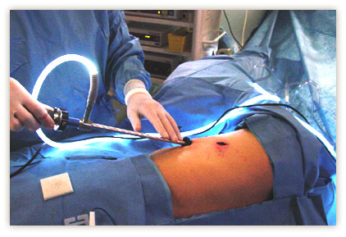
Summary of Patient Stay
8/5/11: RT video assisted thorascopy, lobectomy
8/29/11: Exploratory Re-do, RT thorascop, thoracic duct ligation, possible pleurodesis
Notes:
A thoracoscopy uses an endoscope to visually examine the pleura, lungs, and mediastinum and to obtain tissue for testing purposes. An endoscope is an illuminated optic instrument that is inserted through an incision.
thoracic duct ligation: surgical repair
Pleurodesis is a medical procedure in which the pleural space is artificially obliterated

Slide 21
9/1/11: Nutrition consult ordered for clear liquid diet
9/8/11: Lymphangiograph change possible in thoracic duct
9/11/11: RT thoracotomy decortication, thoracic duct ligation
9/12/11: RT chest tube placement, Full fat diet order, AHA diet order
9/14/11: “Apparently resolved chylothorax, now on regular diet with effusion draining”
Notes:
Lymphangiograph: ALTERATION OF FLOW of lymphatic fluid
Decortication is a medical procedure involving the surgical removal of the surface layer, membrane, or fibrous cover of an organ (lung).

Slide 22
Learning Issues
Gained an extensive knowledge of chylothorax, complications, medical treatments, and MNT.
Investigated why MCT oil is not always the most appropriate choice to boost energy intake
Applied methods for using supplementation in unique medical situations

Slide 23
To summarize…
Chylothorax is a potentially fatal condition in which MNT plays a vital role in the healing process and prognosis of the patient’s outcome.

Slide 24
Research/References
Cerfolio, R. (2003, December 1). Ligation of the thoracic duct for chylothorax. The Cardiothoracic Surgery Network. Retrieved from http://www.ctsnet.org/
Fahimi, H., Casselma, F., Mariani, P., van Boven, W., Knaepen, P., & van Swieten, H. (2001). Current management of postoperative chylothorax. The Annals of Thoracic Surgery, (71), 448-450.
Karagianis, J., & Sheean, P. (2011). Managing secondary chylothorx: the implications for medical nutrition therapy.Journal of the American Dietetic Association, 111(4), 600-604.
Maldonado, F., Hawkins, F., Daniels, C., Doerr, C., Decker, P., & Ryu, J. (2009). Pleural fluid characteristics of chylothorax.Mayo Clinic Proceedings, 84(2), 129-133.
Pakula, A., Phillips, W., & Skinner, R. (2011). A case of a traumatic chyle leak following an acute thoracic spine injury: successful resolution whit strict dietary manipulation. World Journal of Emergency Surgery, 10(1186), 6-10.
Professional refresher chylothorax. (n.d.). Retrieved from http://www.rd411.com

